Slide 1

Delivery Center Food & Goods orders in Brazil
From Raw Data Chaos to an Interactive Operational Dashboard

Slide 2
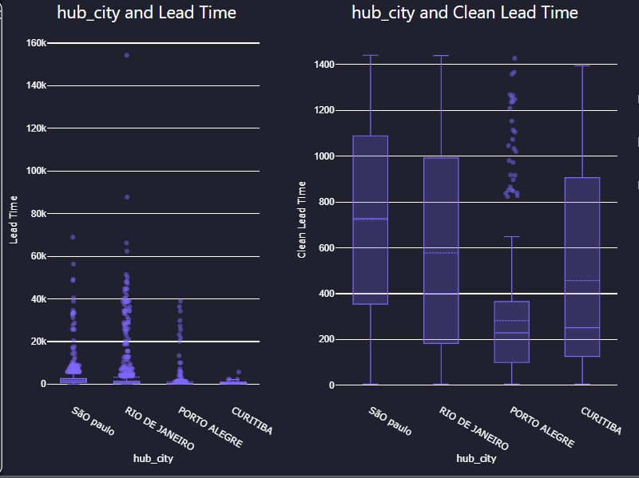
Data Trust & Cleaning
Cleaning the data before trusting any KPI
🚩 The Problem:
~14% of the data (45K+ rows) contained unrealistic values
🛠️ The Fix:
Applied validation rules to remove extreme outliers and incorrect records.
🎯 The Result:
Achieved ~86% clean data, creating a reliable foundation for all KPIs and analysis.

Slide 3
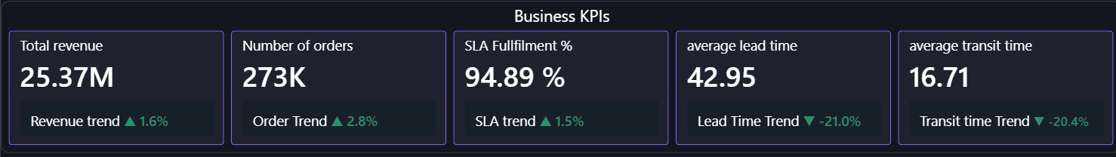
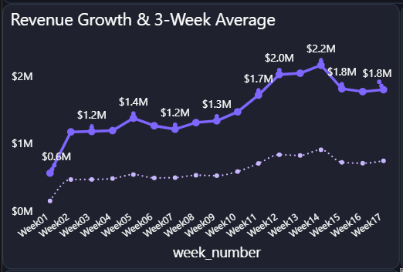
📈 Growth: ● Revenue and orders are going up, showing steady business growth.
⚙️ Efficiency ● Lead time and transit time are going down, so deliveries are getting faster.
🎯 Service ● SLA is staying high, which means performance is consistent.
🔍 Data view ● Using a 3-week average to reduce daily noise and see the real trend
At-a-glance: Business performance is improving

Slide 4
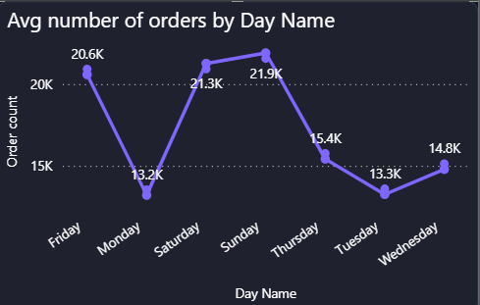
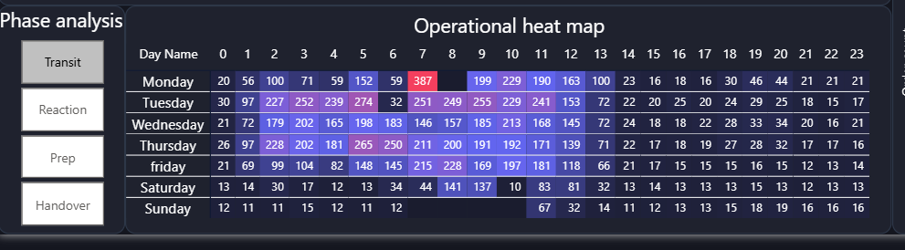
📈 Demand Pattern ● Order volume changes within the week, with clear peak days.
⏰ Peak Hours ● Most orders are concentrated in specific hours during the day.
🔥 Operational Load ● Peak days and peak hours combined create the highest pressure on operations. 🔍These peaks are our main focus points for stuff and resources planning
When and where operations get busy

Slide 5
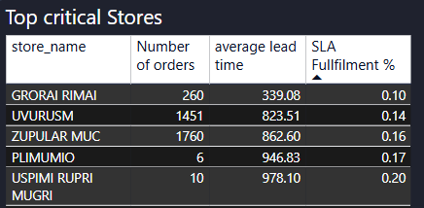
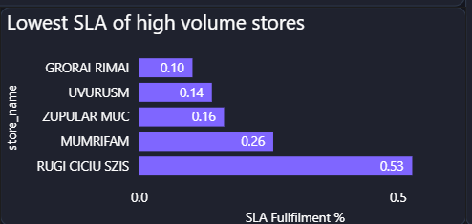
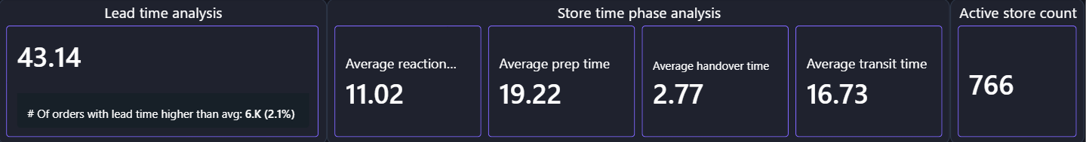
Finding the stores that need immediate action
🎯 Focus Area
Analysis drills down to store level to find underperforming locations.
⚠️ Critical Stores
A small group of high-volume stores shows very low SLA and needs immediate attention.
⏱️ SLA threshold
Goods orders have a lower SLA threshold, but some stores still perform far below target.
Improving these stores can significantly boost overall performance.

Slide 6
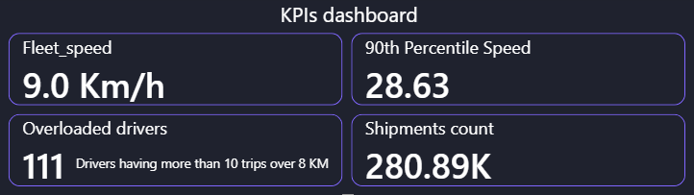
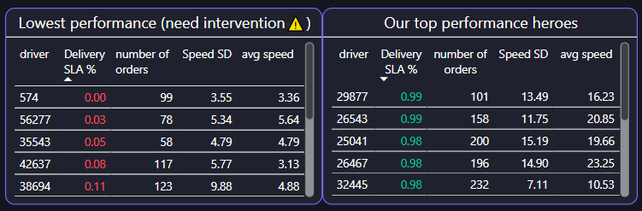
🤝 Driver Utilization Issue: ● Overloaded: 111 drivers (10+ long trips >8km) ● Underused: 197 contracted drivers (≤5 trips in 3 months) → Unbalanced allocation 🐢 Speed Constraint: ● Avg speed: 9 km/h ● Only 10% of trips > 28 km/h → Heavy traffic impact 🎯 Performance Gap: ● Top drivers: ~99% SLA ● Lowest: near 0% → Need training + better routing
You Don’t Need More Drivers. You Need Better Allocation
Imbalance, slow speeds, and performance gaps are hurting delivery efficiency
→ Imbalance + low speed = longer delivery times, higher cost, and lower SLA reliability

Slide 7
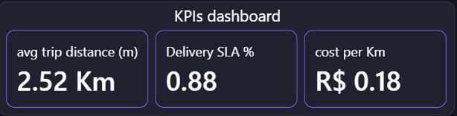
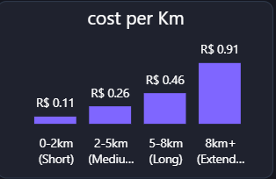
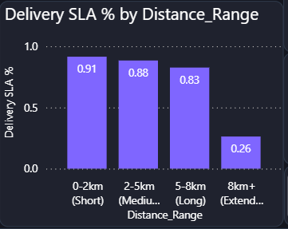
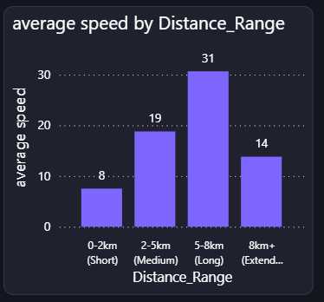
⚠️ Trips above 8km show significantly lower speeds and a sharp decline in SLA performance.
Less than 2% of orders… but they drag performance down
Overall performance looks stable, but long-distance trips significantly underperform.
⚠️ Long-distance trips also tend to increase cost per km
But not all deliveries behave the same…

Slide 8
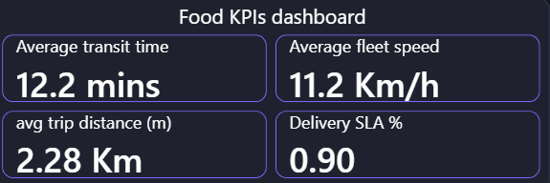
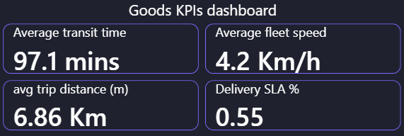
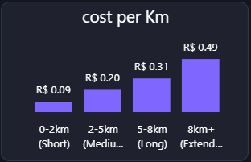
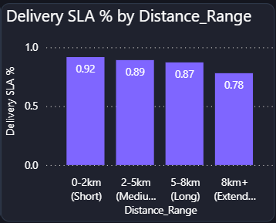
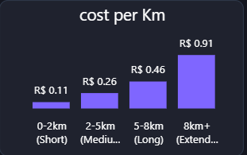
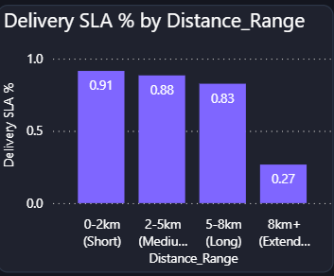
Averages are hiding the problem: Goods underperform across service and cost
Food represents ~95% of orders, while Goods accounts for only ~5%
💡 Goods orders are longer and slower, resulting in lower overall SLA.
💡 Food maintains high SLA even at long distances, while Goods drops sharply beyond 8km.
💰 Cost per km increases with distance for both—but Goods is consistently higher
→ Indicates additional operational delays and higher delivery cost for “Goods” segment.
Goods underperform in both service and cost—even with lower volume and higher SLA threshold

Slide 9
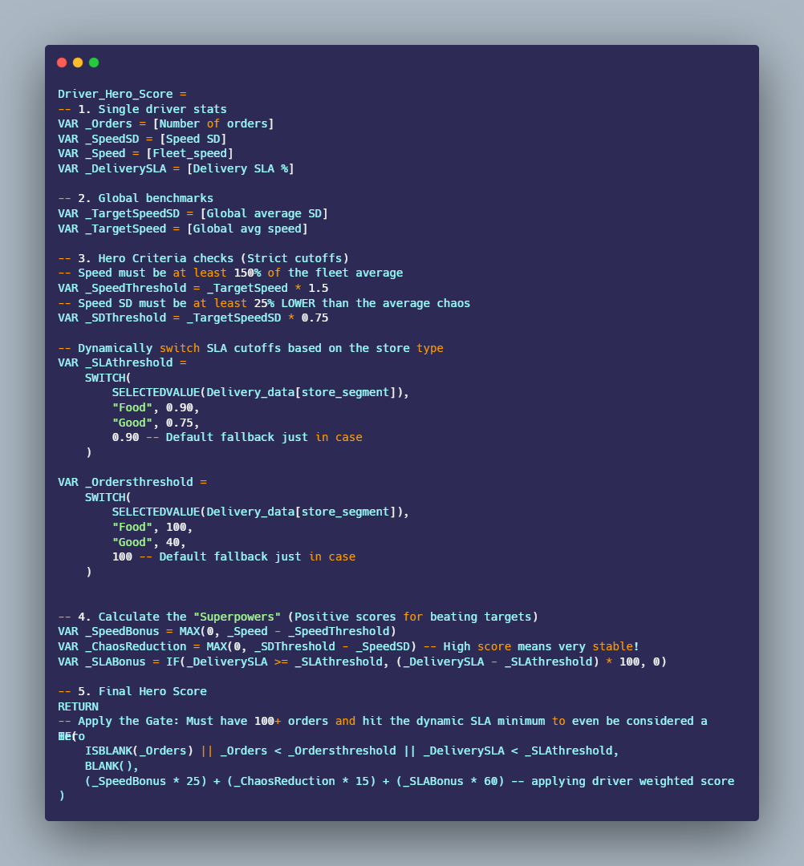
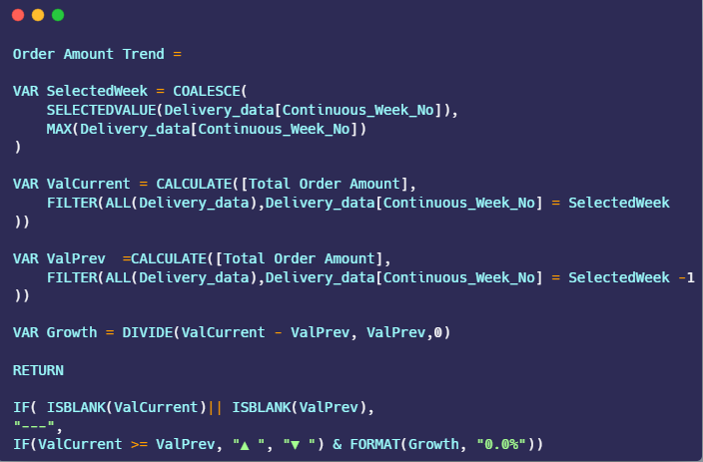
🦸‍♂️ The Hero Score Formula
Ranks drivers based on speed, order volume, and consistency.
Dynamic Cutoffs: Sets lower gates for Goods (40 orders / 75% SLA) vs. Food (100 orders / 90% SLA).
→ Highlights true operational heroes, not just lucky drivers.
📈 Dynamic Week-over-Week Trends
Automatically detects the current week or a user's selected filter
Compares current volume to the previous week's performance.
→ Gives managers a real-time pulse on growth

Slide 10
key insights and business recommendations
key insights
Business recommendations
Data Integrity Gaps: ~14% of raw data contained noise; 90%+ of some timestamps columns were missing. Cleaning was critical to trust KPIs
Volatile Demand: Order volume is unevenly distributed, creating extreme pressure during peak windows.
Failing Stores: A few very busy stores are failing to deliver on time (4 of them below 30% success)
The "Goods" Problem: Even with only ~5% contribution, “Good” deliveries are pulling our overall KPIs down. Most of under performing stores are “Goods” stores, lowest 5 are all Goods type (4 of them running with less than 30% SLA. The problem is systematic, not few outliers
Segment issue: "Goods" stores tend to have lower SLA, higher distance and higher cost per Km comparing to “food“ segment
Overall, performance issues are not everywhere—they are focused on specific segments, stores, and time periods.
Fix Data Recording System: Improving our recording system will give us a stronger foundation for analysis and better decision-making.
Improve Planning for Peak Demand:. Instead of only looking at total resources available, we need to use them more dynamically to balance these fluctuations. A proactive plan will help us stay prepared during peak periods and maintain consistent performance.
Address the Goods Segment Urgently: its poor performance is dragging down our KPIs, customer satisfaction, and reputation. It is also consuming money, time, staff, and effort that could be used elsewhere.
We need to act quickly based on order volume:
High-volume stores: invest in improving performance to meet service level agreements
Low-volume stores: consider closing them and reallocating resources to higher-performing, more profitable store
Small issues in specific areas can have a big impact on overall performance.

